Slide 1
Green Accounting
GDP and its discontents
Environmental product, theory
… and practice
Genuine savings
Alternative indicators
Ecological footprint
Corporate accounting

Slide 2
0 Introduction
1 Social choice
2 Externalities and public goods
3 Decision analysis
4 Valuation: Aims and purpose
5 Valuation: Revealed preferences
6 Valuation: Stated preferences
7 Direct regulation
8 Market-based instruments
9 Complications with instruments
10 Growth and the environment
11 Green accounting

Slide 3
Gross Domestic Production
Gross Domestic Product is the conventional measure of economic performance, tracking the economy over time and, per capita, comparing economies over space
Originally proposed by Simon Kuznets in 1925
“the welfare of a nation can scarcely be inferred from a measurement of national income” – Kuznets, 1932
GDP is a measure of economic activity
Notes:
Motivation for today’s lecture?
If you follow the news at all, you’ll hear a lot about three of the conventional measures of economic performance:
unemployment
inflation
and especially, GDP
Declining GDP means recession;
rising GDP is economic growth,
and economic growth is almost always presented as a wholly positive thing, and as a major goal of policy

Slide 4
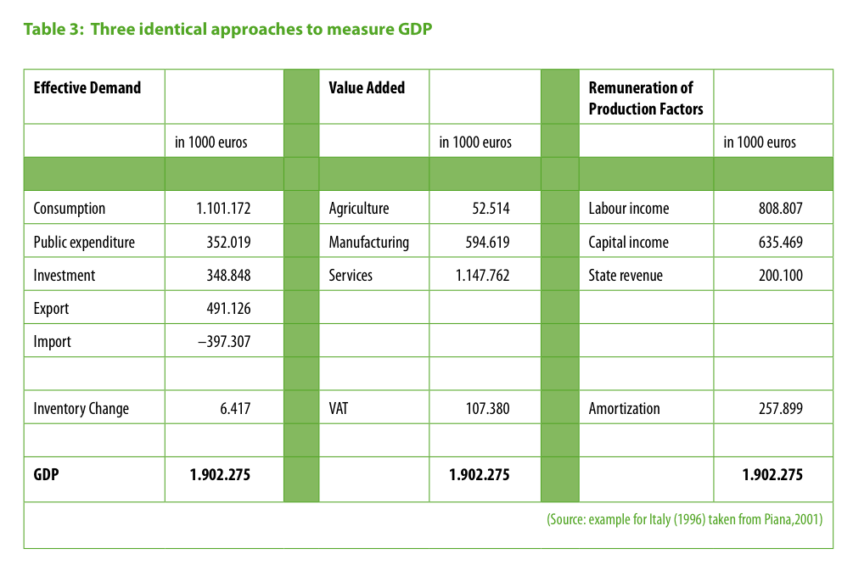
alternative
in million €
in million €
in million €
Notes:
GDP can be measured three ways.
By adding up all expenditure on goods and services (col 1)
By adding up the value added by labour and capital in transforming inputs into outputs (col 2)
- By adding up income received from the production of goods and services:
wages that compensate labour, rent as payment for resources, and profit as reward for entrepreneurial risk-taking (col 3)
Should all come to the same figure. Snapshot of macroeconomic activity.
Italy 1996.
GDP just short of €2tn.

Slide 5
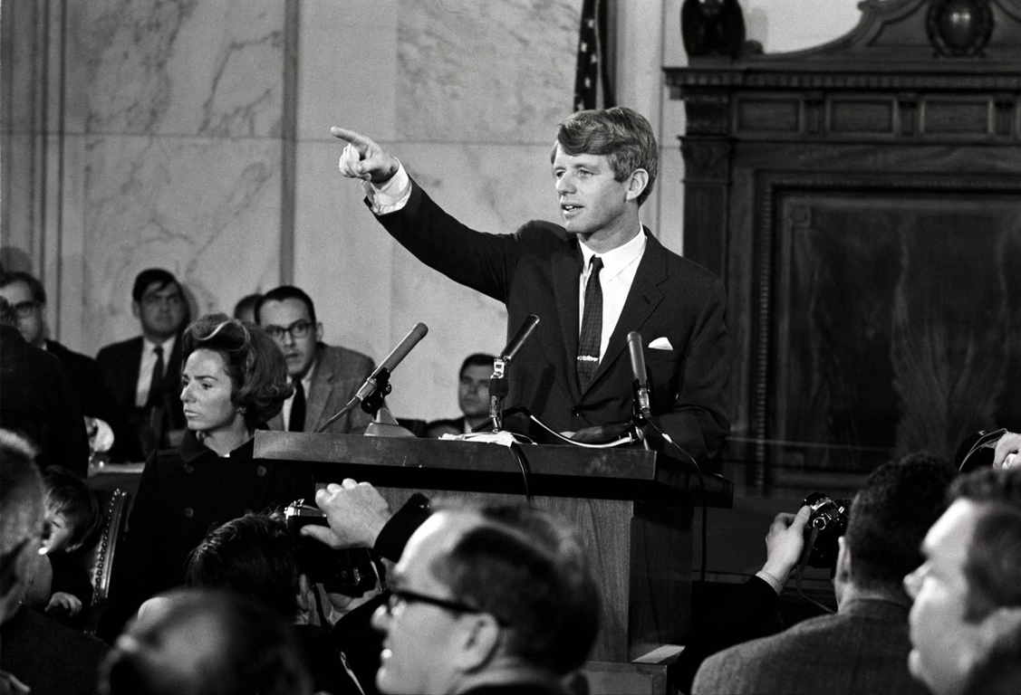
Even if we act to erase material poverty, there is another greater task, it is to confront the poverty of satisfaction - purpose and dignity - that afflicts us all.
Too much and for too long, we seemed to have surrendered personal excellence and community values in the mere accumulation of material things. Our Gross National Product, now, is over $800 billion dollars a year, but that Gross National Product - if we judge the United States of America by that - that Gross National Product counts air pollution and cigarette advertising, and ambulances to clear our highways of carnage.
It counts special locks for our doors and the jails for the people who break them. It counts the destruction of the redwood and the loss of our natural wonder in chaotic sprawl.
Image: University of California, Los Angeles. Library. Department of Special Collections. http://www.oac.cdlib.org/ark:/13030/kt638nd494/
Notes:
And American senator Robert Kennedy made a very poetic speech on this topic in 1968…

Slide 6
It counts napalm and counts nuclear warheads and armored cars for the police to fight the riots in our cities. It counts Whitman's rifle and Speck's knife, and the television programs which glorify violence in order to sell toys to our children.
Yet the gross national product does not allow for the health of our children, the quality of their education or the joy of their play. It does not include the beauty of our poetry or the strength of our marriages, the intelligence of our public debate or the integrity of our public officials. It measures neither our wit nor our courage, neither our wisdom nor our learning, neither our compassion nor our devotion to our country, it measures everything in short, except that which makes life worthwhile.
And it can tell us everything about America except why we are proud that we are Americans. If this is true here at home, so it is true elsewhere in world.
Image: University of California, Los Angeles. Library. Department of Special Collections. http://www.oac.cdlib.org/ark:/13030/kt638nd494/
Notes:
And American senator Robert Kennedy made a very poetic speech on this topic in 1968…

Slide 7
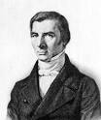
Why not GDP?
Investment but not depreciation
Broken window fallacy
Net Domestic Product
Limited to market transactions
Home work
Subsistence farming
Defensive expenditure
Crime
Environment
…
Distribution of income
Freedom
Notes:
Motivation for today’s lecture?
If you follow the news at all, you’ll hear a lot about three of the conventional measures of economic performance:
unemployment
inflation
and especially, GDP
Declining GDP means recession;
rising GDP is economic growth,
and economic growth is almost always presented as a wholly positive thing, and as a major goal of policy

Slide 8
Notes:
Finally, changes in capital stocks, including natural capital, are not reflected. Environmental degradation and resource depletion are not accounted for.
(Which is really the same point we saw Stiglitz making about assets and liabilities just now, but since this is an env econ course it bears picking out specifically).

Slide 9
Environmental Net Domestic Product
GDP = C + I
NDP = C + I – D
EDP = C + I – D + P – N
Notes:
So how is that operationalised?
Saw that GDP is consumption + gross investment.
Net Domestic Product — as perhaps implied by that point about GDP, subtracts capital depreciation from GDP.
But before we get excited, that’s not all kinds of capital. It’s just fixed or manufactured capital: vehicles, machinery, and so on.
In the last 10 years NDP has been about 15% lower than GDP for European countries. The difference has increased with increasing technological development because capital — especially hardware and software — becomes obsolete and needs replacing frequently.
(Why not used instead of GDP? Eurostat: “Consumption of fixed capital is one of the most difficult national accounts concepts to measure, so GDP is usually preferred for pragmatic reasons.”
— So even dm, depreciation of manufactured capital, is hard to measure — and that, in principle, has market prices.
But for a sustainability measure, this depreciation isn’t nearly enough. What if we’re digging non-renewable resources such as coal out of the ground, and harvesting a renewable resource such as fish faster than it can regenerate?
We should account for depreciation of our natural capital too. If we subtract this, this gives us our sustainable income — our quote from Hicks.
So that’s a sustainable income measure. Now what about changes in total wealth or capitals? Well, just subtract C.
Now — we talked earlier in this module about environmental valuation … but effectively, valuation on this scale — dn, encompassing literally everything — is impossible.
So what people have done is calculate measures based on these ideas. Because we cannot practically value everything, these measures are not complete. On the other hand, in some cases these measures try to fix some of the other shortcomings of GDP too.

Slide 10
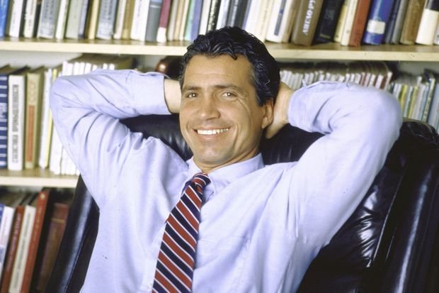
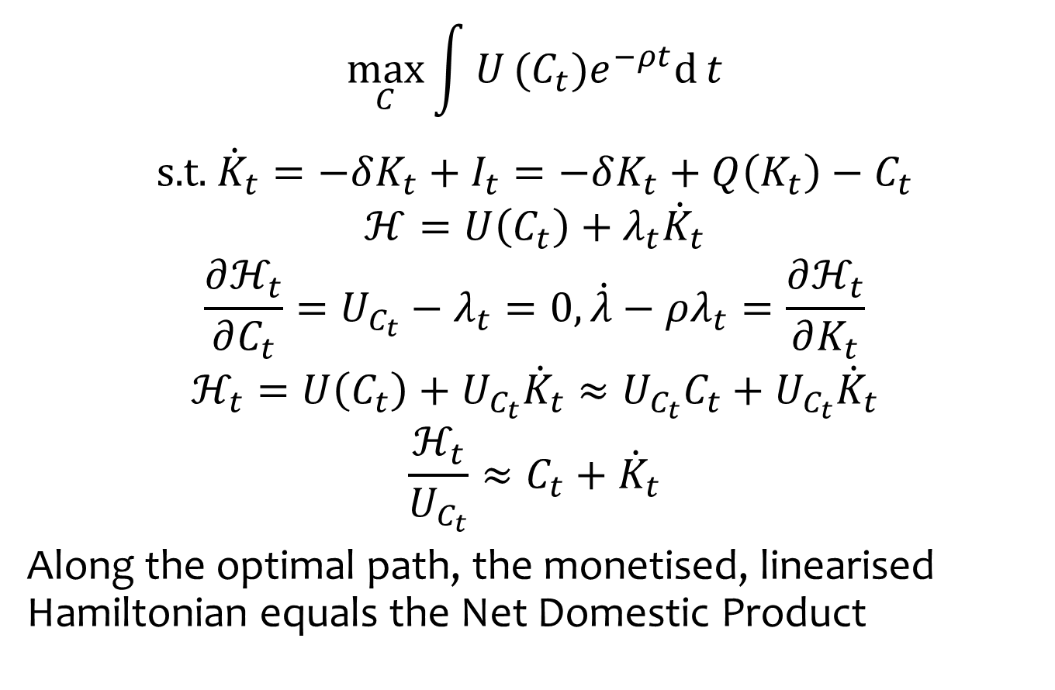
Welfare significance of national product
$$\max_{C}\int{U}(C_{t})e^{−ρt}\text{d}{t}$$
$$\text{s}\text{.}\text{t}\text{.} { \dot{K}}_{t}=−δK_{t}+I_{t}=−δK_{t}+Q\left(K_{t}\right)−C_{t}$$
$$ℋ=U\left(C_{t}\right)+λ_{t}{\dot{K}}_{t}$$
$$\frac{∂ℋ_{t}}{∂C_{t}}=U_{C_{t}}−λ_{t}=0, \dot{λ}−ρλ_{t}=\frac{∂ℋ_{t}}{∂K_{t}}$$
$$ℋ_{t}=U\left(C_{t}\right)+U_{C_{t}}{\dot{K}}_{t}≈U_{C_{t}}C_{t}+U_{C_{t}}{\dot{K}}_{t}$$
$$\frac{ℋ_{t}}{U_{C_{t}}}≈C_{t}+{\dot{K}}_{t}$$
Along the optimal path, the monetised, linearised Hamiltonian equals the Net Domestic Product

Slide 11

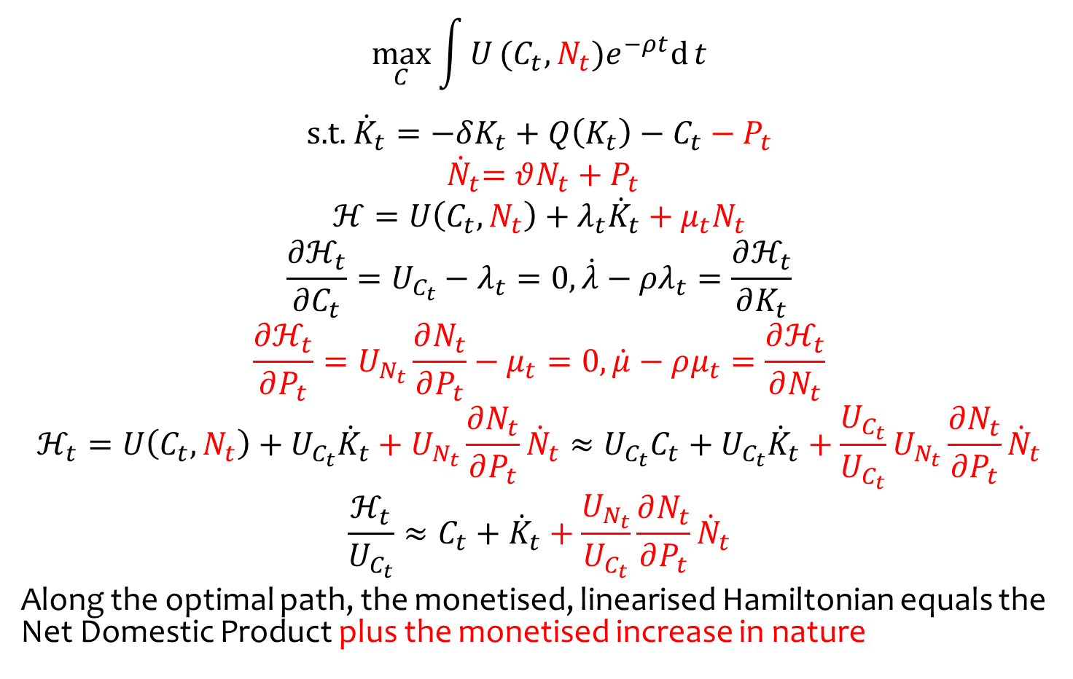
with nature and protection
$$\max_{C}\int{U}(C_{t},N_{t})e^{−ρt}\text{d}{t}$$
$$\text{s}\text{.}\text{t}\text{.} { \dot{K}}_{t}=−δK_{t}+Q\left(K_{t}\right)−C_{t}−P_{t}$$
$${ \dot{N}}_{t}=θN_{t}+P_{t}$$
$$ℋ=U\left(C_{t},N_{t}\right)+λ_{t}{\dot{K}}_{t}+μ_{t}N_{t}$$
$$\frac{∂ℋ_{t}}{∂C_{t}}=U_{C_{t}}−λ_{t}=0, \dot{λ}−ρλ_{t}=\frac{∂ℋ_{t}}{∂K_{t}}$$
$$\frac{∂ℋ_{t}}{∂P_{t}}=U_{N_{t}}\frac{∂N_{t}}{∂P_{t}}−μ_{t}=0, \dot{μ}−ρμ_{t}=\frac{∂ℋ_{t}}{∂N_{t}}$$
$$ℋ_{t}=U\left(C_{t},N_{t}\right)+U_{C_{t}}{\dot{K}}_{t}+U_{N_{t}}{\frac{∂N_{t}}{∂P_{t}}\dot{N}}_{t}≈U_{C_{t}}C_{t}+U_{C_{t}}{\dot{K}}_{t}+\frac{U_{C_{t}}}{U_{C_{t}}}U_{N_{t}}\frac{∂N_{t}}{∂P_{t}}{\dot{N}}_{t}$$
$$\frac{ℋ_{t}}{U_{C_{t}}}≈C_{t}+{\dot{K}}_{t}+\frac{U_{N_{t}}}{U_{C_{t}}}{\frac{∂N_{t}}{∂P_{t}}\dot{N}}_{t}$$
Along the optimal path, the monetised, linearised Hamiltonian equals the Net Domestic Product plus the monetised increase in nature

Slide 12
Measure of Economic Welfare
Nordhaus & Tobin, 1972
Measure of consumption
not production
MEW = GNP – economic ‘bads’ (repairs, pollution control) – regrettable necessities (police, defense) + household & illegal production, leisure
‘Primitive & experimental’
But influential, incarnated as the index of sustainable economic welfare / genuine progress indicator / sustainable net benefit index / measure of domestic progress
Annuity of services by durables, human capital
Notes:
First sustainable income-like measure: MEW/ISEW.
NEF & Friends of the Earth keen

Slide 13
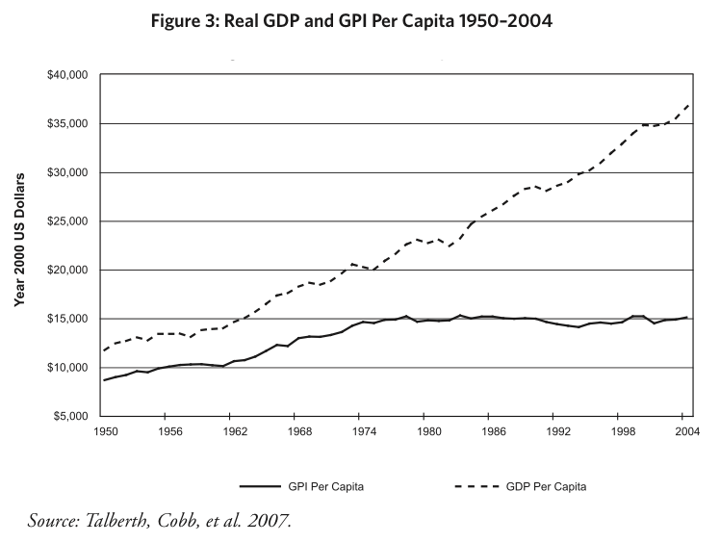
Notes:
Nice thing: easily comprehensible and GDP-like, so you can do this kind of thing (US data)
Threshold effect? Manfred Max-Neef, 1995

Slide 14
Limitations
Valuation issues
Depletion of non-renewables
Cumulative costs of environmental damage
Somewhat arbitrary
What expenditure is defensive? How bad is inequality?
Therefore manipulable
Confused
What affects current welfare need not affect sustainability, and vice versa
Weak sustainability
adding and subtracting capitals
Notes:
Economists hate it

Slide 15
Office of National Statistics
ONS publishes the UK Environmental Accounts and the UK Natural Capital Accounts
Environmental Accounts
Limited to emissions to air – no water, soil
Heavy emphasis on energy and carbon dioxide – political priority, but ONS supposedly neutral
Particulates, heavy metals
Expenditure on environmental protection
Environmental tax revenue
Materials flow accounts
No valuation
Notes:
Motivation for today’s lecture?
If you follow the news at all, you’ll hear a lot about three of the conventional measures of economic performance:
unemployment
inflation
and especially, GDP
Declining GDP means recession;
rising GDP is economic growth,
and economic growth is almost always presented as a wholly positive thing, and as a major goal of policy

Slide 16
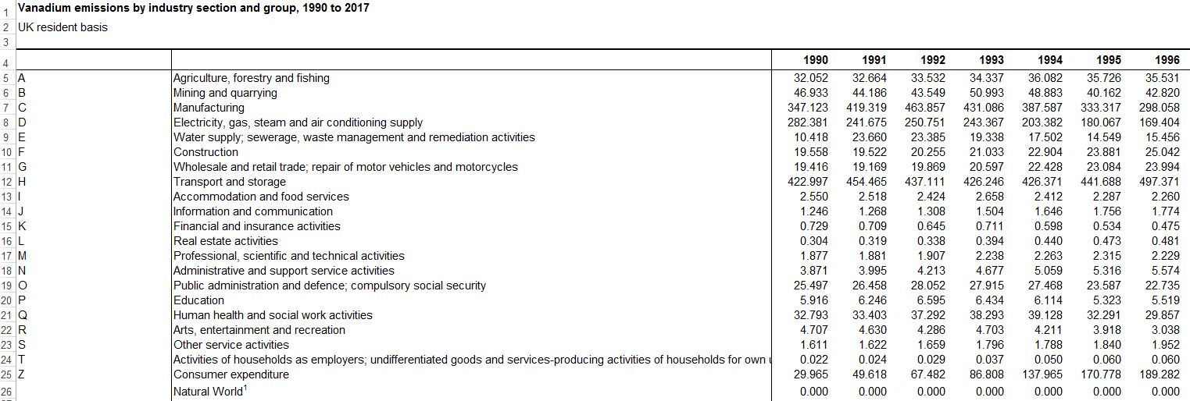
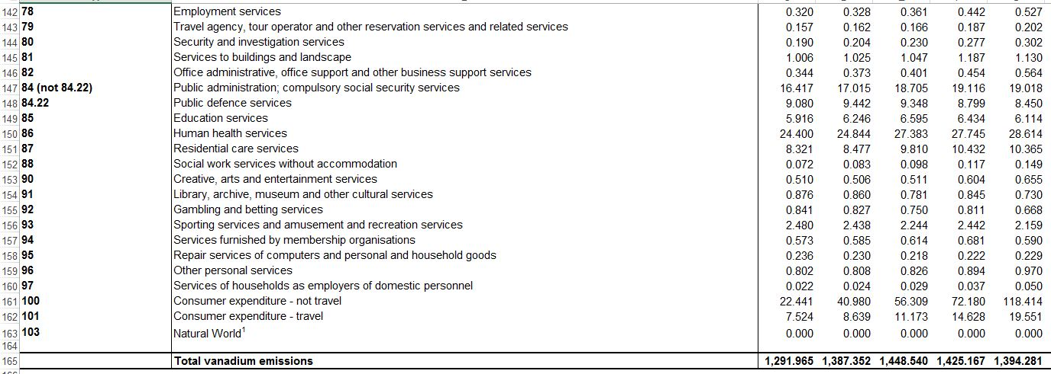
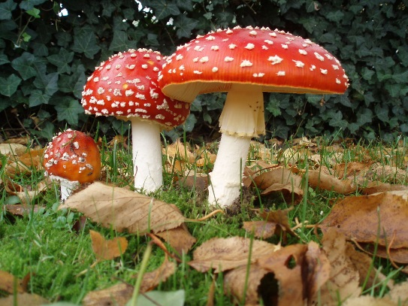

Slide 17
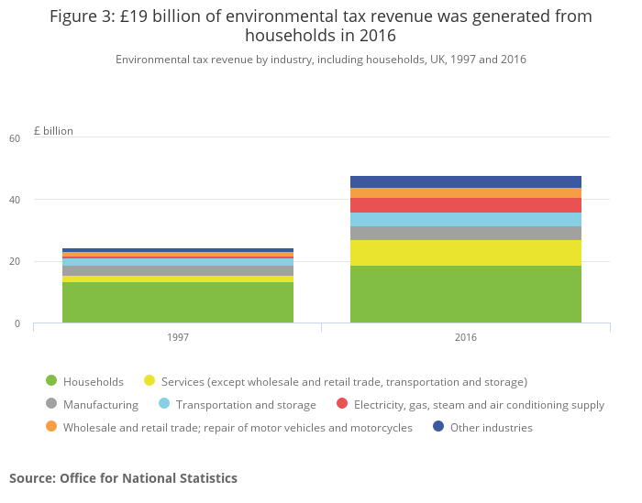

Slide 18
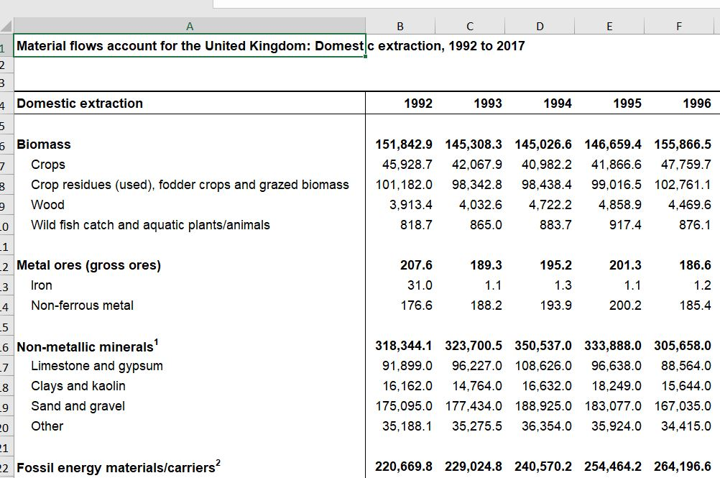

Slide 19
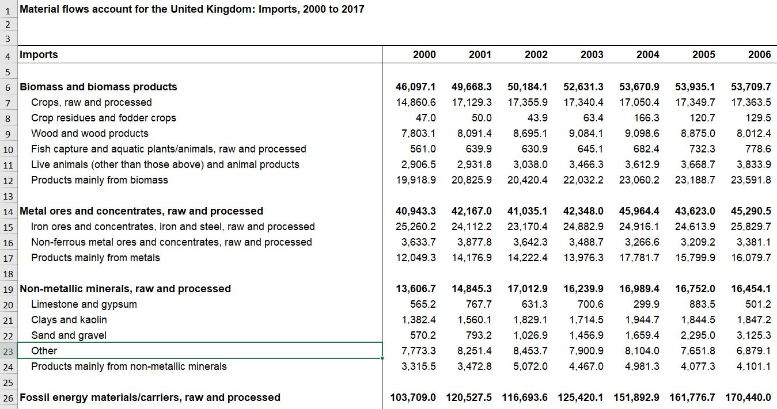

Slide 20
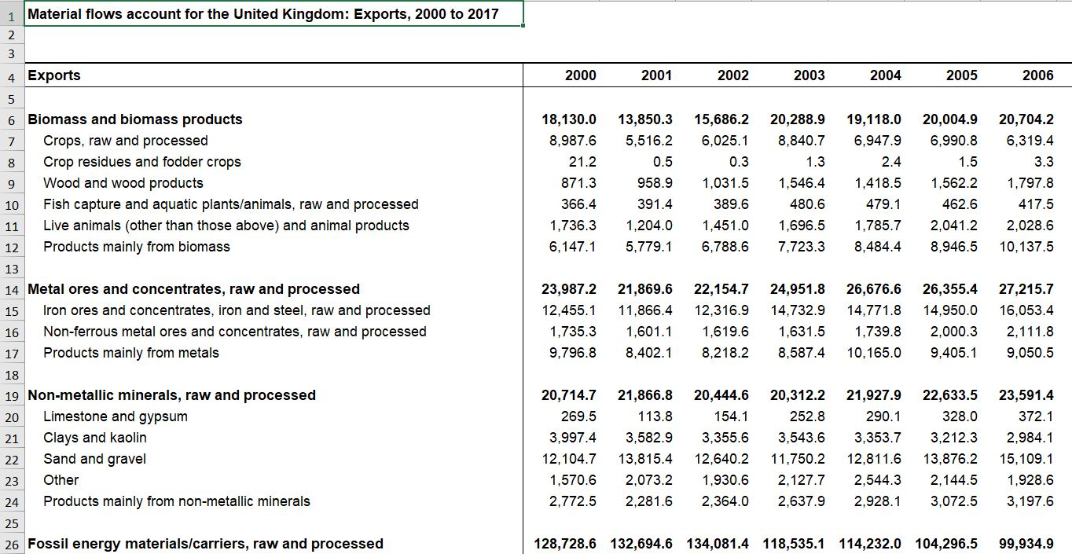

Slide 21
ONS Natural Capital Accounts
Annual value of services provided by nature for
Provisioning
Agriculture
Fishing
Timber
Mining
Regulating
Carbon sequestration
Air pollution removal
Noise mitigation
Cooling
Culture
Recreation
House prices
Notes:
Motivation for today’s lecture?
If you follow the news at all, you’ll hear a lot about three of the conventional measures of economic performance:
unemployment
inflation
and especially, GDP
Declining GDP means recession;
rising GDP is economic growth,
and economic growth is almost always presented as a wholly positive thing, and as a major goal of policy

Slide 22
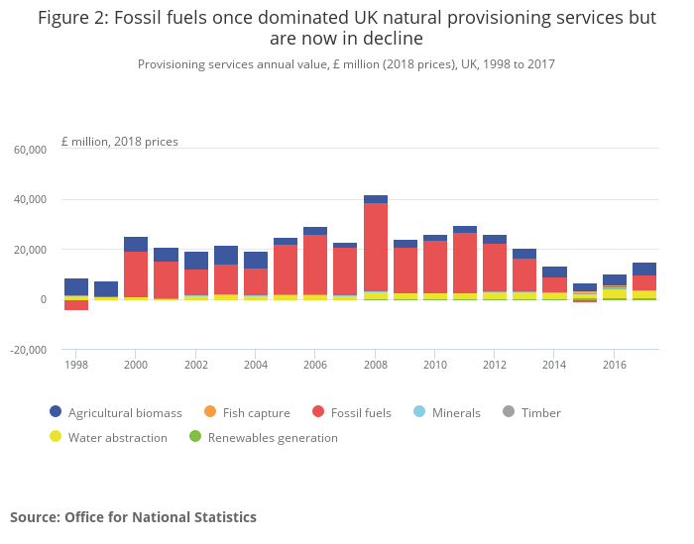

Slide 23
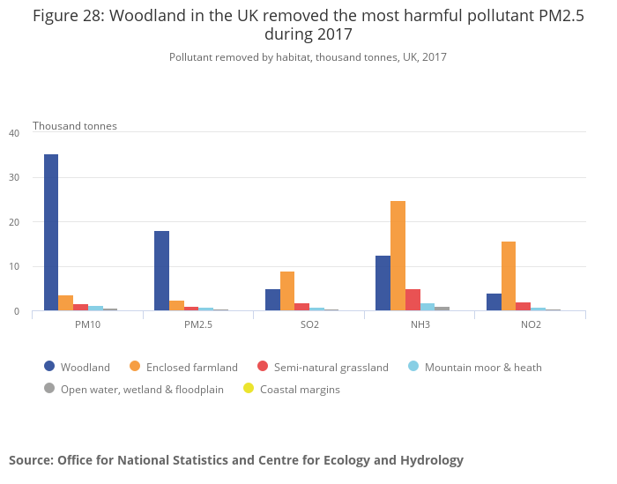

Slide 24
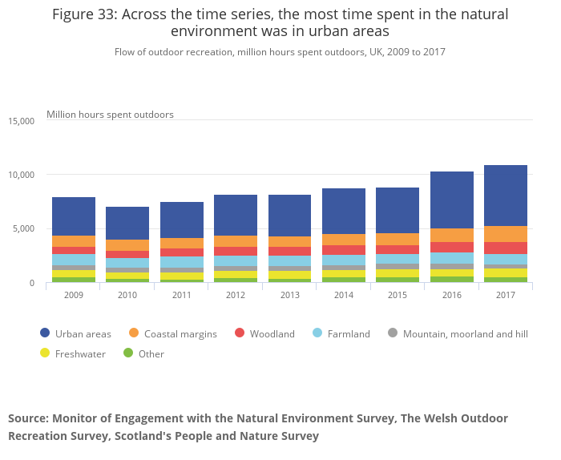

Slide 25
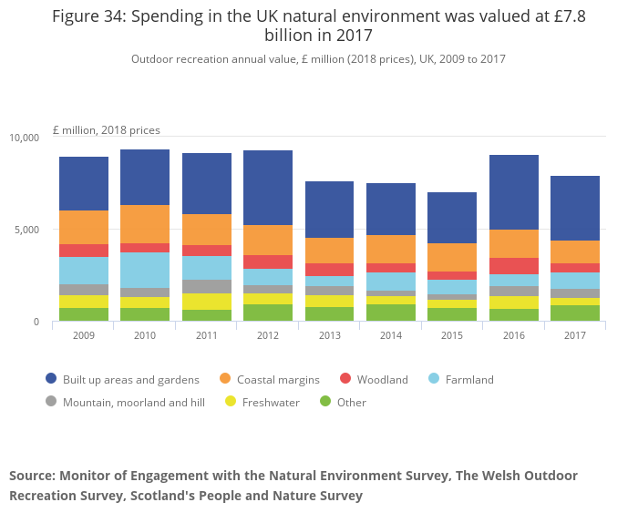

Slide 26
Threshold hypothesis
“For every society there seems to be a period in which economic growth brings about an improvement in the quality of life, but only up to a point — the threshold point — beyond which, if there is more economic growth, quality of life may begin to deteriorate” – Max-Neef, 1995
Notes:
While this may be true, not clear that ISEW is brilliant evidence for it — arguably built in to the methods for valuing depletion.

Slide 27
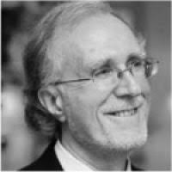
Genuine Saving
aka Adjusted Net Saving
World Bank’s sustainability measure
GS = Net investment in manufactured capital
Net depreciation of natural capital
+ Net investment in human capital
GS(t) = ΔEDP(t) = EDP(t+1)-EDP(t)
Measures investment in future consumption
Explicitly about capital, wealth
GS < 0 is unsustainable
GS ≥ 0 is weakly sustainable
Notes:
Our second real-world sustainability measure in this section is Genuine Saving.

Slide 28
GS = net investment in manufactured capital
– net depreciation of natural capital
+ net investment in human capital
Notes:
GS tries to operationalise the idea of measuring changes in total wealth.
Now, as we said earlier, measuring even just the changes in total wealth (and not even total wealth itself) is effectively impossible. So what GS sets out to measure is less than this: … (no social capital)

Slide 29
GS = – net investment in manufactured capital
– extraction of some fossil fuels and minerals, and forests – $20/ton emitted carbon – health damage costs of PM10
+ education spending (cap and op)
Notes:
But in practice, it currently does this:
education spending a very crude measure of human capital investment — but readily available in many countries over long periods

Slide 30
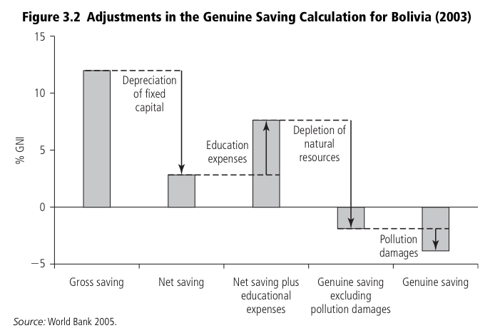
Notes:
Example calculation: Bolivia.
Not even weakly sustainable.

Slide 31
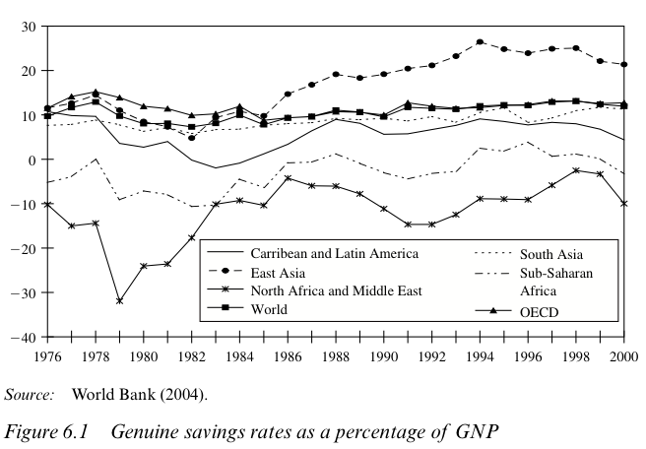
Notes:
Across world. Note: expressed as % of GNP. I.e. as a savings rate rather than simple savings.
East Asia high
North Africa and Middle East low

Slide 32
Adjusted net savings, 2016

Slide 33
What’s missing?
Natural capital
Fisheries
Soil erosion
Water pollution
Diamonds
…
but Wealth Accounting & Valuation for Ecosystem Services (WAVES)
Human capital
Depreciation (death)
…
Social capital
Investment efficiency
Notes:
Data issues. Need data for many countries over long periods. Some of these things are non-trivial to value. And there are hundreds of them.
But being worked on all the time…

Slide 34
Alternative indicators
Human development index
GDP per capita
Life expectancy at birth
Adult literacy rate (2/3), enrolment ratio (1/3)
Scale from zero to one
Average
Ecological Footprint
Strong sustainability
Happy Planet Index
Life Satisfaction x Life Expectancy / Ecological Footprint
(2.7-8.0) x (44-75) / (0.02-100)
Notes:
Motivation for today’s lecture?
If you follow the news at all, you’ll hear a lot about three of the conventional measures of economic performance:
unemployment
inflation
and especially, GDP
Declining GDP means recession;
rising GDP is economic growth,
and economic growth is almost always presented as a wholly positive thing, and as a major goal of policy

Slide 35
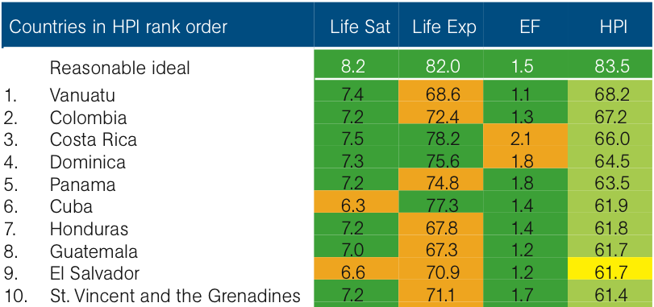
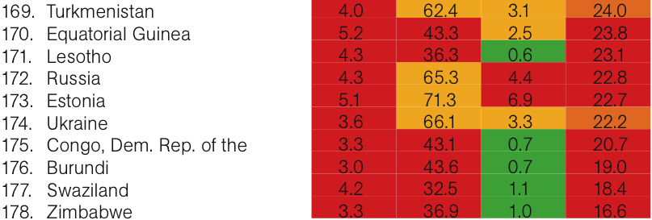
Notes:
Top 10 and bottom 10 countries, with a breakdown of their scores.
Generalisations we can draw from these: it’s good to be an island, and it’s good to be South American.
It’s bad to be formerly Communist, and it’s bad to have war or political instability.
Notice there are no really rich countries at the top of the list — because their EF is so high.

Slide 36
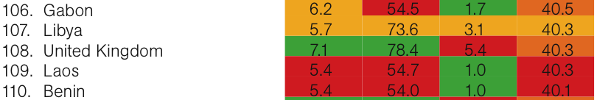
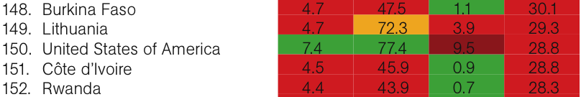
Notes:
Here are the UK and US, at 108 and 150 out of 178.
(EF = hectares/person?)
And this is the main point that the HPI brings across. The US and UK and other western democracies are on average the richest, healthiest and happiest nations
— but compared to many other countries in the world we are deeply inefficient (even wasteful) in turning the fruits of nature into happy healthy lives.

Slide 37
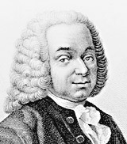
Ecological Footprint
Ecological limits embodied in land
“Appropriated carrying capacity”
Land area required to provide resources and assimilate wastes …
… vs. land area available
Physiocrats reborn
Wackernagel & Rees (1996)
Notes:
This is the idea behind the EF.
Embodies the idea of ecological limits in land area.
This is a bio-physical qty — unlike the capitals approach, where it’s all monetary, with no upper bound.
ACC = original title (Wackernagel’s PhD).
Sustainability would mean we’re not consuming more services than those that flow sustainably from the land available.

Slide 38
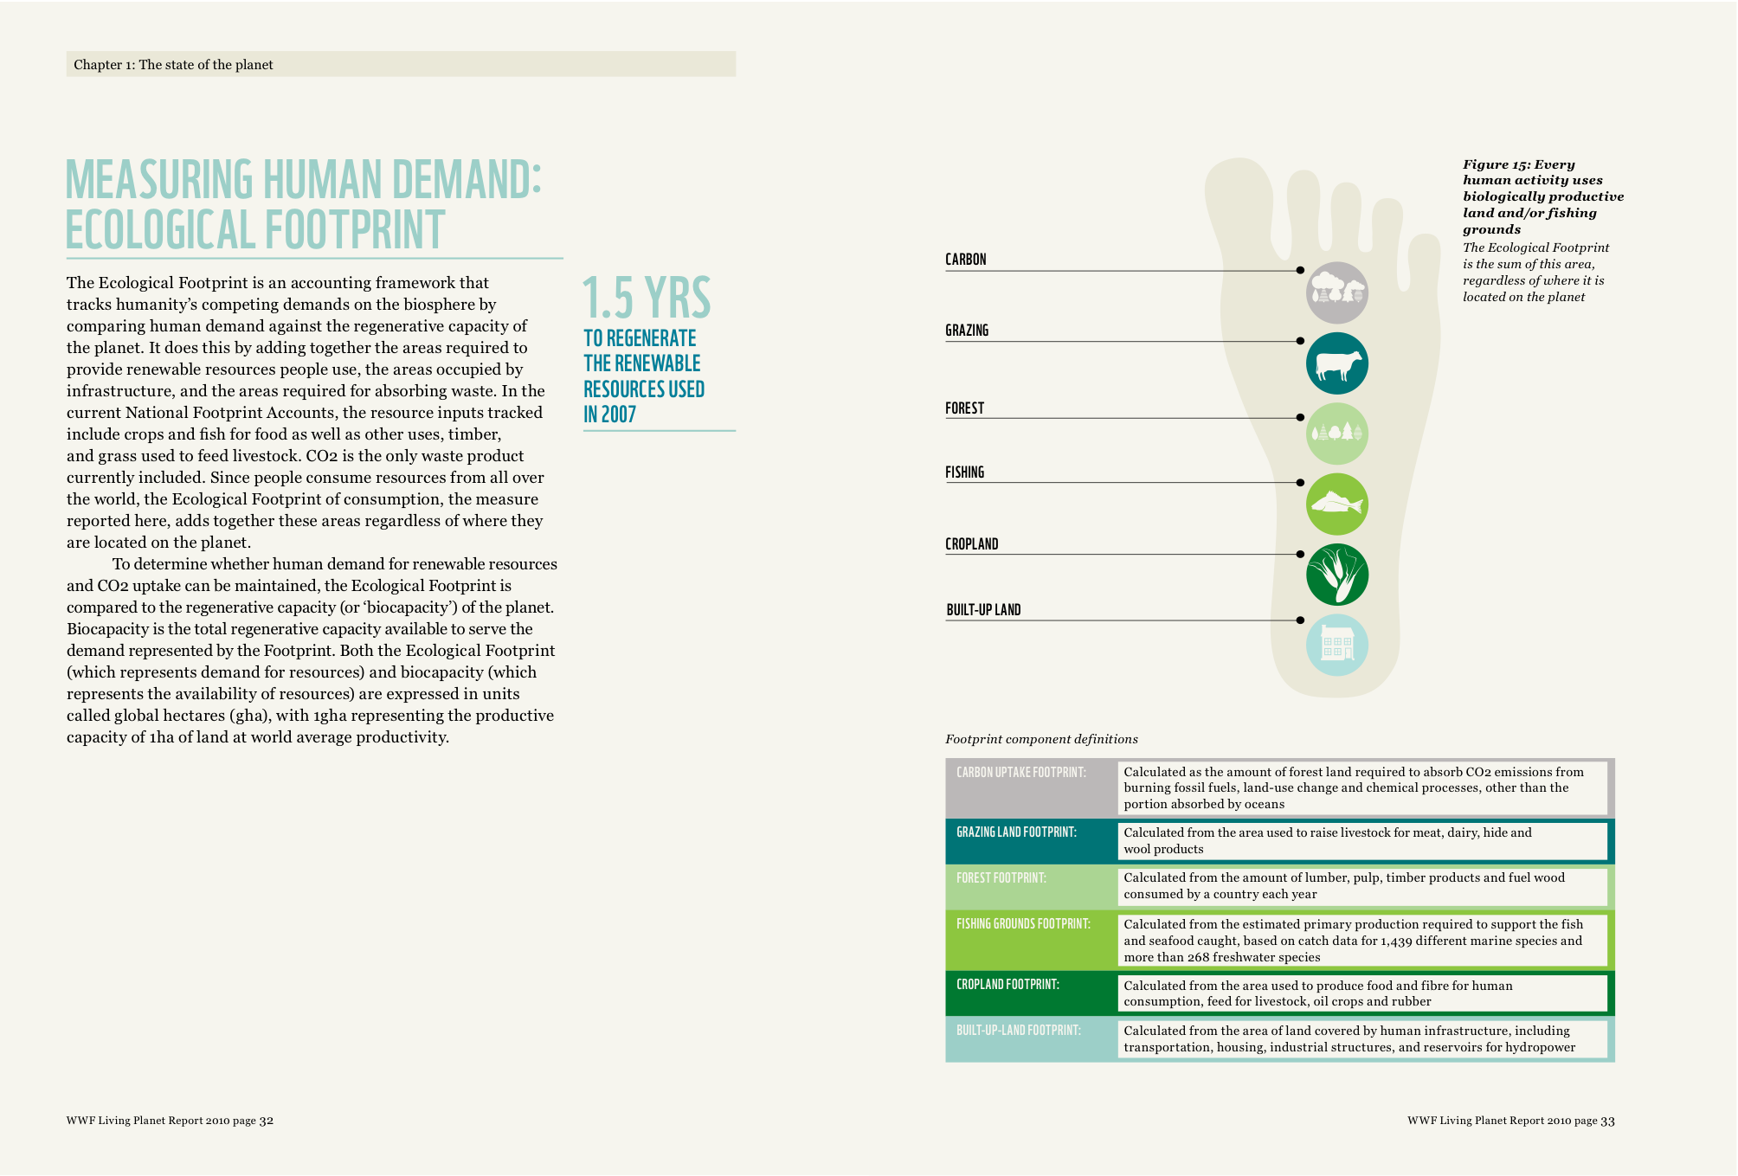
Notes:
WWF Living Planet reports give a nice summary of the components of the EF.
[go through it?]

Slide 39
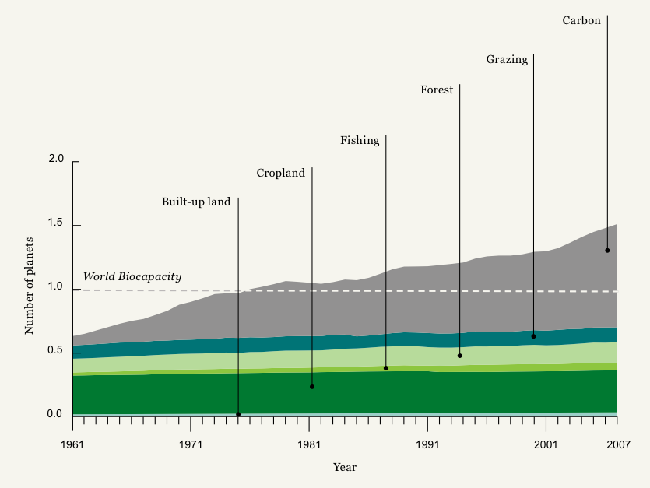
Notes:
1961 - 2007
Measure biocapacity in planet Earths — and we have exactly one.
Since the mid 70s we’ve been using more than one planet’s resources — i.e. taking more than just the interest on our natural capital.
And what’s pushed us over that threshold? Taking us back to last week’s topic: CO2. Everything else has increased only rather slowly.

Slide 40
Fossil fuel consumption
Awkward: not about land
Accounted for by waste: CO2
Amount of hypothetical forestry land required to sequester
Arbitrary: why not hypothetical biofuel cultivation, wind turbines, CCS projects, insulation schemes, …
More than half the global footprint
Sensitivity!
Carbon footprint more useful than ecological footprint?
Notes:
Now, actually, it’s a bit problematic for the EF that this represents such a big share.
Because one of the main limitations of ecological footprint is its ability to deal with fossil fuel consumption adequately.
…

Slide 41
Other limitations
Waste
Carbon only
Toxins? Nuclear waste?
Water
Whose land area?
Typically nation by nation
Autarky, anti-trade
Strong sustainability
But implies full substitutability between different kinds of natural capital
Notes:
Nuclear — took into account land around Chernobyl taken out of productive use to state that nuclear is equivalent to fossil fuels
Excellent for teaching and other communications.
Too tree-hugging for most economists!

Slide 42
Corporate Accounting
Companies report environmental performance to
(Prospective) customers
(Prospective) regulators
(Prospective) workers
(Prospective) investors
Five largest public companies in UK
HSBC
Unilever
BP
BHP Billiton
AstraZeneca
Notes:
Our second real-world sustainability measure in this section is Genuine Saving.

Slide 43
HSBC is focussed on the
environmental impact
of its investment portfolio
and loan book.

Slide 44
Unilever:
Good products,
good processes,
good employer

Slide 45
BP sets targets for its operational emissions, and reports on its performance.
Argues for climate policy.
No liability for use of its products.

Slide 46
BHP Billiton is focussed on
operational
performance.
Sustainability
report not just on
environment.

Slide 47
AstraZeneca is proud of its paper tigers.

Slide 48
Corporate Accounting
Lots of glossy material
Little standardization
You would be hard-pressed to discern which company does best, or which exceeds expectations
Sustainability reports are audited, but that just tells you that the reporting is truthful, not that the reporting is complete or useful
Certification imposes little discipline
Notes:
Our second real-world sustainability measure in this section is Genuine Saving.

Slide 49
Summary
Some progress towards environmental accounting of countries and companies
More numbers than insights
Notes:
Our second real-world sustainability measure in this section is Genuine Saving.

Slide 50

Vote tactically
Don’t vote Tory
Notes:
Our second real-world sustainability measure in this section is Genuine Saving.

